Slide 1

Hello Doctor Online Doctor’s Appointment System
Presented By
Abdullah Al Nayim
CSE 063 07519
Sanzida Islam Suchi
CSE 063 07514
Md. Nur-E-Alam Shikdar CSE 063 07431

Slide 2

What is Hello Doctor ?
Hello Doctor will be a online doctor chain management application. A user can make an appointment remotely by internet with his desired doctor. Moreover, some doctors will be available for treat their patients by video conference. Day by day we will add more facilities like online medicine shop with home delivery call an ambulance on emergency, pay your doctor with online payment.

Slide 3
Mission
Reducing people’s suffering to appoint with a doctor and give them a complete medical support software application.
How it will Work
In this software, we will provide a list of different specialized doctors of different discipline. We engaged them under a network. Every doctor have to sing up with an account and same to users. First of all, user has to select the category of the doctor form a drop down list. Then user can set an appointment with him in a application form and got confirmation. If the users want to consult instantly they can engage with a doctor by video call on emergency doctor panel.

Slide 4
Required Tools to Develop
1. Operating System
2. Net beans IDE 3. DBMS
4. GPS Tracker

Slide 5
Requirements for maintenance
Dedicated Server for DBMS
Computers
Experts Man Power

Slide 6
Implementation Cost
Development Cost : 5, 00000 (Approx)
Maintenance Cost Per year : 10, 00000 (Approx)

Slide 7
Feasibility
After a time frame, users have to pay an yearly charge to use this Application.
Some Services will remain free.
A user will need to pay for using Premium services like getting prescription, direct video conference with specialized doctor.

Slide 8
Required Tools to Develop
1. Operating System
2. Net beans IDE 3. DBMS
4. GPS Tracker
Requirements for maintenance
Dedicated Server for DBMS
Computers
Experts Man Power
Implementation Cost
Development Cost : 5, 00000 (Approx)
Maintenance Cost Per year : 10, 00000 (Approx)
Financial Profit
After a time frame, users have to pay an yearly charge to use this Application.

Slide 9
Services
Remotely request an appointment with your desired specialized doctor.
Consult with online doctors instantly by video conference. Get your prescription in need.
Chat with different specialized doctors.
Order medicine from online medicine shop and get home delivery.
Call an Ambulance.

Slide 10
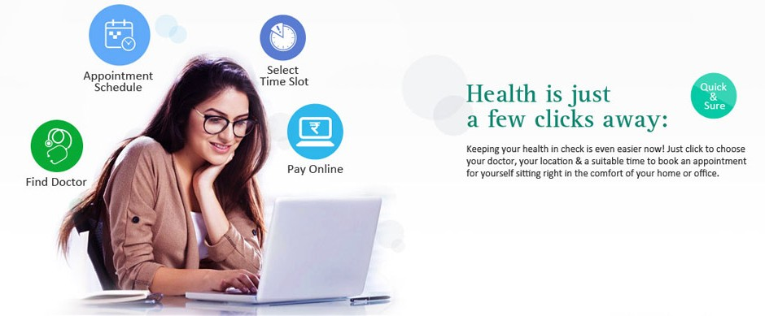
How to Request an Appointment?

Slide 11
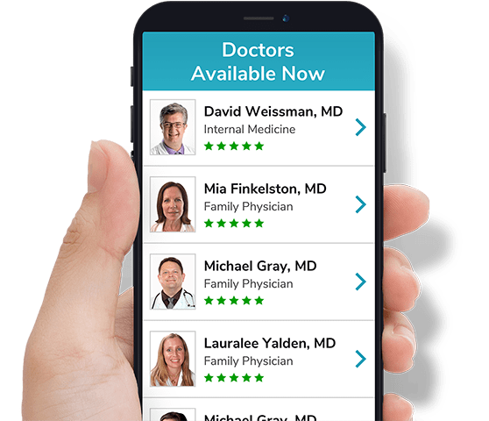
How to consult with doctor at online ?
It’s simple. We have doctors from different field of specialization. So, at first Choose your desired field’s doctor.

Slide 12

Then, receive your prescription !

Slide 13

When our doctors are available ?

Slide 14
Why you should use Hello Doctor ?
It will save your time and money and make yourself free from all sufferings to appoint a doctor .
You can consult from home at your convenient time of 24/7.
Get relief from the sufferings of traffic when you need to consult a doctor or need emergency medicine.
Easy payment methods.

Slide 15

We wish your Good Health

